Slide 1
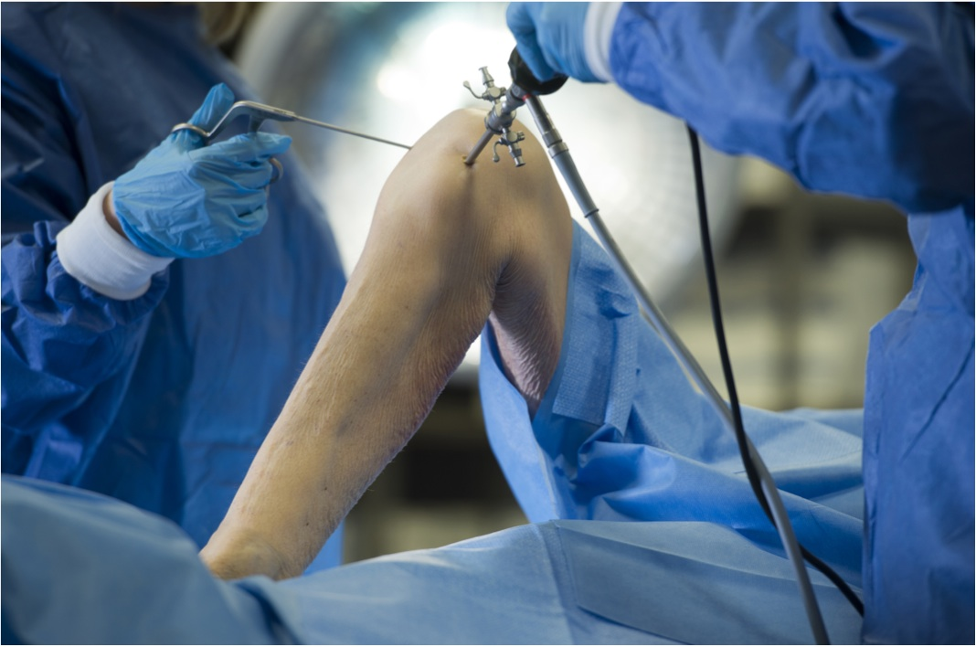
With Kind Support from
Bristol Soft Tissue Knee Cadaveric Course
6th – 7th November 2015
Course conveners: Mr Richard Barksfield and Mr James Robinson
Venue: Vesalius Clinical Training Centre
Southwell Street, Bristol, BS2 8EJ.
Course outline: The course will cover the range of solutions available for treating soft tissue knee injuries. Delegates will hear lectures on various knee repair topics and will then have the opportunity to perform these techniques during hands-on cadaveric laboratory sessions. There will be an opportunity to discuss complex cases and participate in in-depth discussions with the faculty.
Course Fee: £295 (BOTA Members £265)
To register please contact :
Carole Wood Orthopaedic Administrator
B302 King Edward Building, Bristol Royal Infirmary, Bristol, BS2 8HW,
Tel: 01173 4 422878. Carole.Wood@UHBristol.nhs.uk.

Slide 2
With Kind Support from
Agenda
DAY 1 – Friday 6th November 2015
Course Convenors: James Robinson and Richard Barksfield
08.00 Registration and coffee
08:20 Lecture Theatre : Welcome & Introduction
08:30 Lecture: Strategies for Anatomic ACL reconstruction
08.45 Lecture: ACL reconstruction – How I do it.
09:00 Lab Session 1 – ACL Reconstruction
Anatomy Demo: ACL Anatomy
Delegates perform Anatomic ACL Reconstruction
10:30 Coffee & interaction time with faculty
Lecture Theatre – Meniscus and Cartilage
Video Techniques
11:00 How to Improve medial exposure – MCL piecrust
11:05 All-Inside Meniscal Repair (FasT-fix 360)
11:15 Inside-Out and Outside–In Techniques to Repair the Meniscus
11:30 RF Coblation in the Knee
11:45 Lab Session 2 – Meniscal Repair + RF Coblation
Delegates perform MCL pie-crust / Outside-In &
All-inside meniscal repair / Cartilage coblation
13.15 Lunch & interaction time with faculty

Slide 3
With Kind Support from
Agenda
DAY 1 – Friday 6th November 2015
Lecture Theatre: Medial Side and MPFL
14:00 Lectue: MCL Anatomy and Current Reconstruction concepts
14:15 Lecture: Surgical Treatment of Patella Instability
14:30 Lab Session 3 – Medial Side
Lab Demo – Anatomy of the Medial Side
Lab Demo – MPFL reconstruction
Delegates perform MPFL recon. and dissect Medial anatomy
16.00 Coffee & interaction time with faculty
Lecture Theatre : PCL and Revision ACL
16.30 Lecture - PCL Reconstruction
16:50 Lecture - Revision ACL reconstruction: How to approach it.
17:10 Adjourn
2000 Dinner at the Glassboat Restaurant, Welsh Back, Bristol, BS1 4SB. (Included in fee)

Slide 4
With Kind Support from
Agenda
DAY 2 – Saturday 6th November 2015
08.45 Coffee & interaction time with faculty
Lecture Theatre
09.00 Discussion Session: Rehabilitation for ACL & Meniscal Repair
09.20 Difficult Cases……
10.00 Coffee – & interaction time with faculty
Lecture Theatre
10.30 Lecture: ACL with Extra-articular plasty – is the Anterolateral ligament needed ?
10.45 Posterolateral Corner Reconstruction
11.00 Lab: PLC Anatomy Demonstration
Delegates perform PLC dissection and perform Extra-articular- plasty
12:45 Lunch & interaction time with faculty
13.00 Lab Session
Lab Demo: 5 and 6 strand Hamstring Graft Prep
Lab Demo: BTB harvest
Lab Demo: Quad Tendon Harvest
Delegates perform Anatomic Dissection/ Graft Harvest / Prep
15:30 Adjourn and Wrap up

Slide 5
Return with a copy of your CV to :
Carole Wood
Orthopaedic Administrator
B302 King Edward Building, Bristol Royal Infirmary, Bristol, BS2 8HW,
Tel: 01173 4 422878. Carole.Wood@UHBristol.nhs.uk.
With Kind Support from
Registration Form
Name …............................................
Grade …............................................
Unit …............................................
Rotation …............................................
Address …............................................
…............................................
…............................................
…............................................
…............................................
Post Code …............................................
Telephone Contact …............................................
Email Contact …............................................
Speciality Interest …............................................

