Slide 1
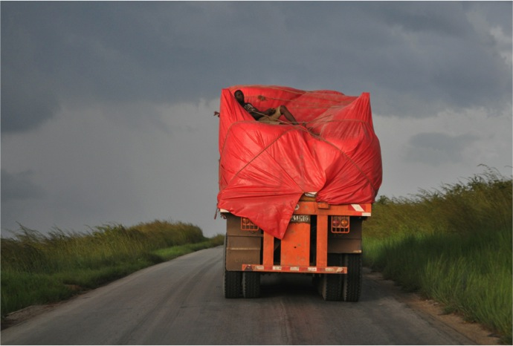
Making the conveyor belt work for you
WHISTLE, Cambridge September 2016
Elizabeth Khadija Tissingh MBBS MSc MRCS

Slide 2
Making the conveyor belt work for you
It is ok to get off
Tick all the boxes, early
Have a plan, a flexible plan
Make it easy for everyone else

Slide 4
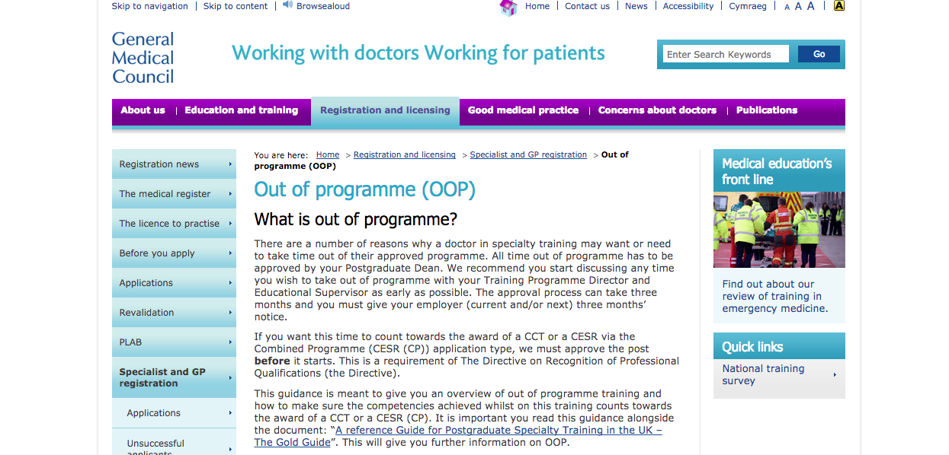
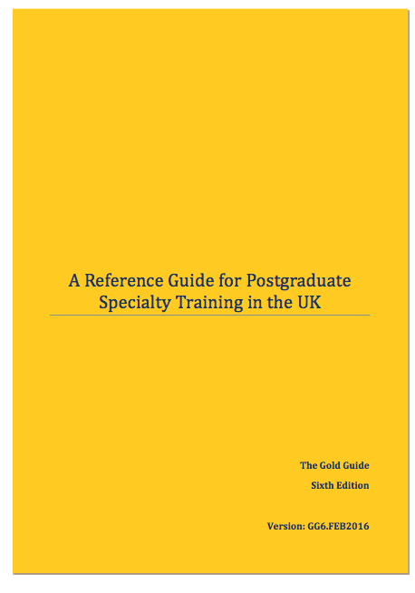
OOPC, OOPE, OOPT, OOPR

Slide 5
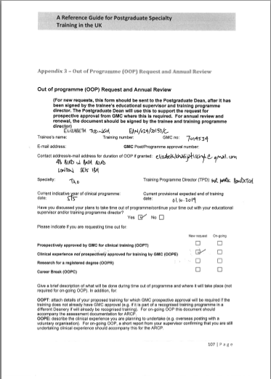
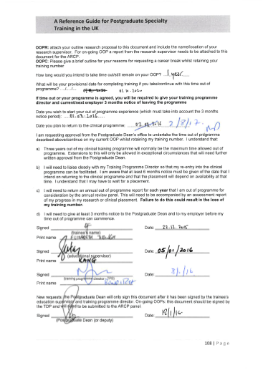
Educational supervisor, TPD, postgraduate dean

Slide 7
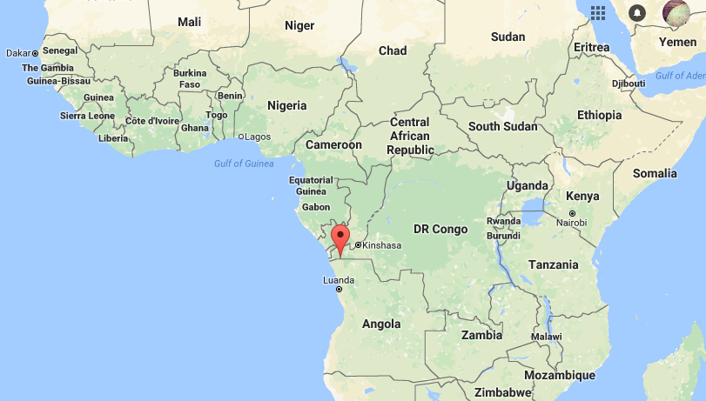
Matadi
Kongo Central province
Democratic Republic of the Congo

Slide 8
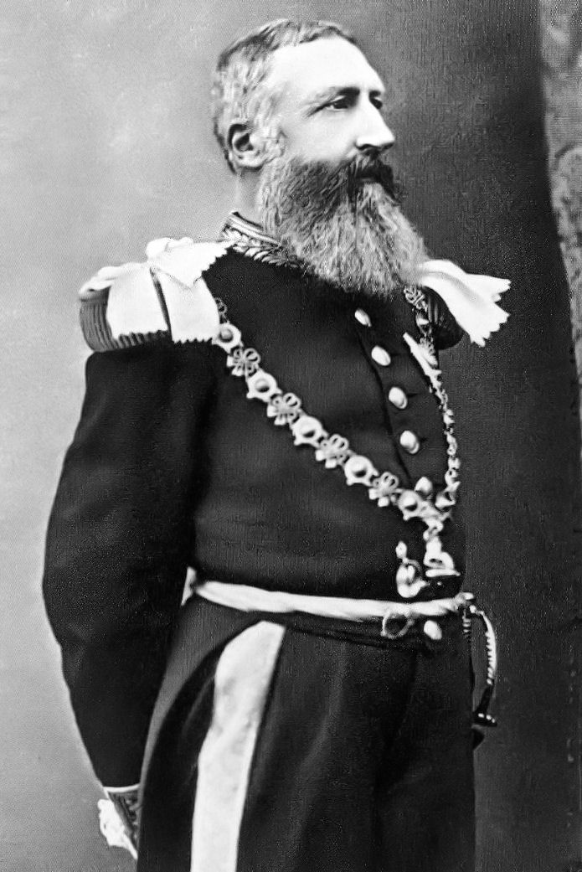
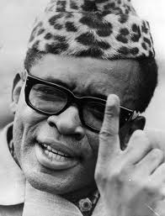

Slide 9
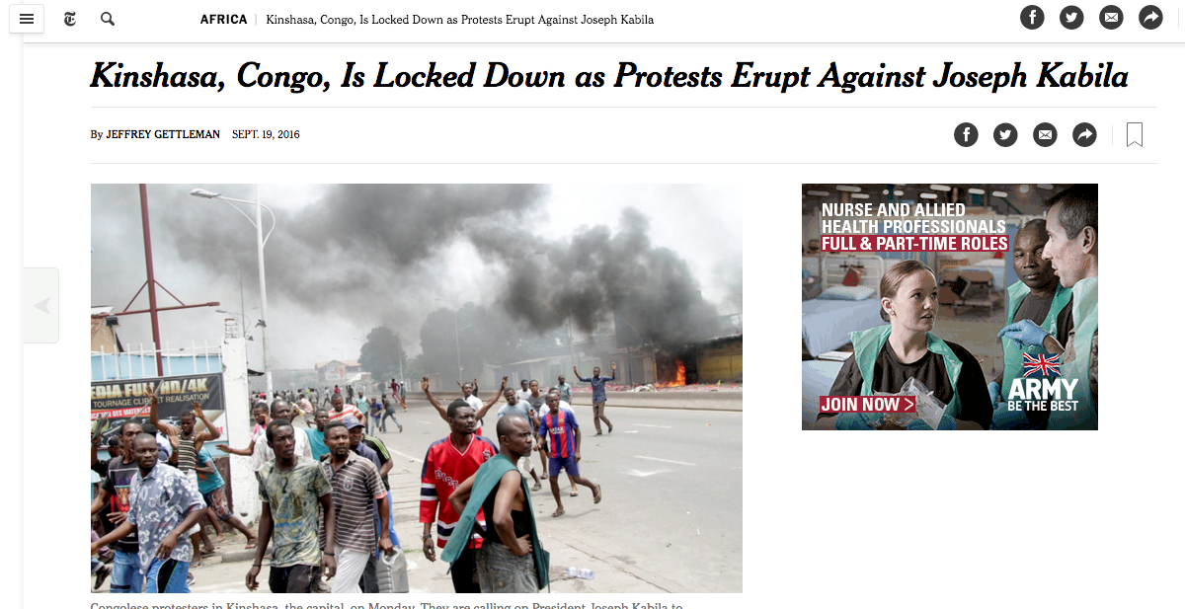

Slide 10
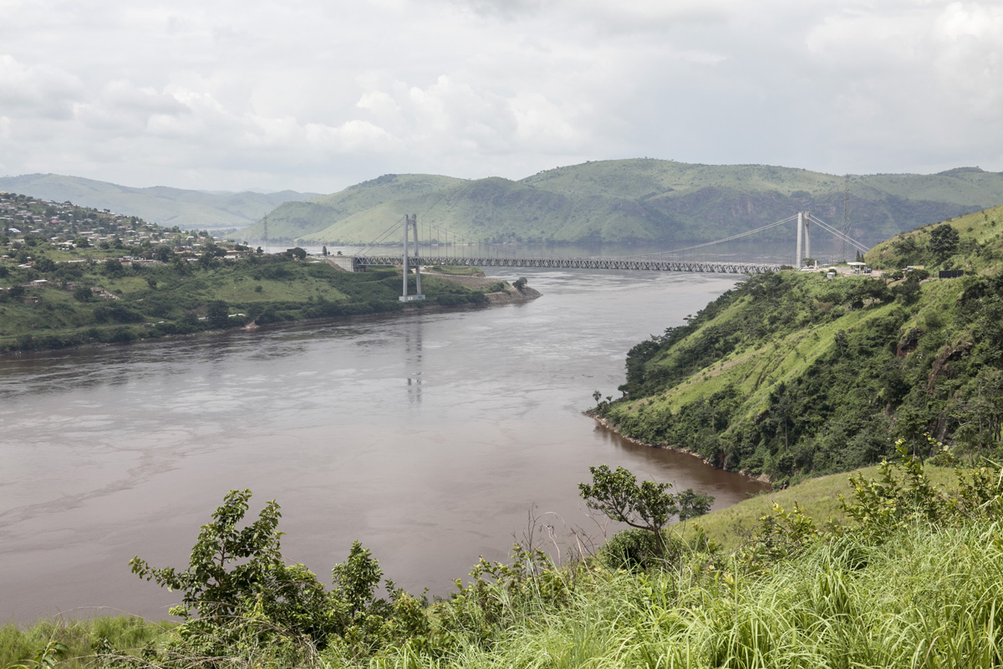
Notes:
Country of plains

Slide 11
King’s Kongo Central Partnership
Clinical care
Teaching and training
Policy
Research

Slide 12
