Slide 1
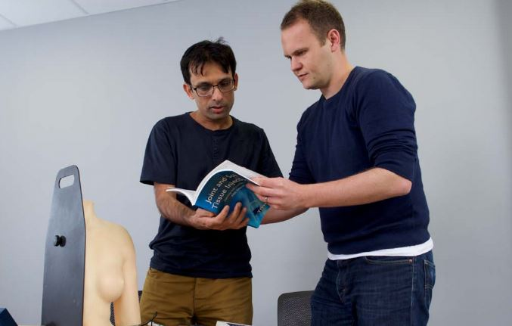


Study leave
Heman Pathmanandam Ian Barton
Associate Dean Deputy Dean

Slide 2
Principles
Providing clarity
Ensuring equity of access
Improving access to local and regional teaching
Prioritising delivery of the curriculum
Flexibility
Monitoring attendance and quality
Commissioning training
@NHS_HealthEdEng

Slide 3
Funding Arrangements
Locally delivered teaching.
Regional study days
Simulation training programmes
Other regionally-commissioned internal courses
External courses which are explicitly required by the relevant curriculum
External courses which are a cost-effective way of delivering parts of the relevant curriculum
Life support courses when these are curriculum requirements.
Other individual training needs required to meet the curriculum, as agreed in individual trainees’ PDPs
@NHS_HealthEdEng

Slide 4
Excluded expenses
Enrolment on to training programme and payment for portfolio access
ALS/life support courses which are not curriculum requirements
Statutory and mandatory training required by employers
Other employer-related leave
Bursaries for medical education courses unless they are curriculum requirements
Fellowships (e.g. simulation fellows)
Professional examination fees at any point of training
Courses for specialty examinations during Foundation Programme
Interview Leave
@NHS_HealthEdEng

Slide 5
Individual study leave requests
The trainee may apply for individual study leave funding for: curriculum requirements and aspirational activity.
The Trusts local application process must always be followed for both of the above applications.
An additional sign off from the TPD will be required for the following:
- Curriculum requirements exceeding £600
- All aspirational requests

Slide 6
Curriculum requirements
May submit claims for activity that have been explicitly identified as requirements of the trainee’s specialty’s curriculum and/or ARCP decision aid.
Activities can be signed off at Trust level provided the total cost (including the costs of the activity, travel and subsistence) is £600 or less.
For activities that cost more than £600, additional sign off from the TPD (or Head of School if TPD is unavailable) will be required.
The curriculum requirements have been identified by the TPD in each specialty and will be reviewed and confirmed by the Head of School, then updated on the HEE EoE website.
@NHS_HealthEdEng

Slide 7
Aspirational activities
Activities that are not explicitly recognised as requirements for the trainee’s curriculum.
Activities that may help the trainee complete parts of the curriculum.
It is essential that any aspirational activity is included in the trainee’s PDP.
Will require an additional level of sign off from the TPD (or Head of School if TPD is unavailable).
The trainee will be expected to provide a supporting statement
The trainee must have received (or be on track to do so) an outcome 1 at their latest ARCP in order to be eligible.
Exam preparation courses are included in the ‘aspirational’ requests, again the trainee will need an outcome 1 at ARCP or an outcome 2 or 3 for exam failure.
@NHS_HealthEdEng

Slide 8
Aspirational Guidelines
Act sensibly and professionally
Adhere to local trust process with regards to study leave approval.
Aspirational activities are activities that will help the trainee complete part of their curriculum, which the trainee has not already completed
Consider if it is possible to achieve similar outcomes from local/regional programmes, or a cheaper external course - has the most cost effective choice been made.
The activity must have been included in the trainee’s PDP.
Aspirational activities can only be approved if the trainee has obtained an outcome 1 or 6 at their most recent ARCP (or is on track to do so).
Trainee who has received an outcome 2 or 3 for exam failure alone will be able to apply for examination preparation courses only (until they have passed the exam)
There is the possibility of ‘partial funding’
When funding costing over £600 is approved, the Trust must be notified that this has been agreed e.g. a copy of the signed form sent to the Medical Education Manager.
Equitable and effective.
@NHS_HealthEdEng

Slide 9
Application Process
Secondary Care:
Trainees must apply via their local application process for any claim for study leave they would like to make. This could include sign off from the rota co-ordinator, ES/DME and MEM. It is important to remember the approvers may vary from Trust to Trust.
If the application is for an aspirational activity (any amount) or a curriculum requirement exceeding £600 the trainee must also obtain sign off from their TPD using the HEE EoE additional sign off form.
Once all required approval has been obtained and the costs have been incurred, the trainee claims reimbursement of expenses from their employing Trust.

Slide 10
Application Process
General Practice:
Trainees need to follow the local Trust or Practice process for approval of time off.
If the course is for an aspirational activity or a curriculum requirement exceeding £600 they will also require additional sign off from the TPD using the HEE EoE additional sign off form.
Once all required approval has been obtained and the costs have been incurred, the trainee claims reimbursement of expenses from HEE EoE are reimbursed by the lead employer.
We are currently working on amalgamating the HEE EoE additional sign off form with the HEE EoE claim form to reduce form filling.

Slide 11
Regional Teaching Fund
The Regional Teaching Fund has been identified by the Head of School during their Annual School Development Plan meeting and will be funded via the study leave budget.
This includes things like:
- Regional teaching
- Simulation activity
- Locally delivered training
The allocated funding for each School will be transferred to the most appropriate Trust to be managed, this is usually where the Head of School is based.

Slide 12
Developing local courses
Where multiple applications for the same or similar courses
Can the same training be delivered locally or regionally?
If so, use the ADP process to develop the new course
The expectation should then be that the trainees will attend the local course – saving on travel and external course fees

Slide 13
Questions?

