Slide 1
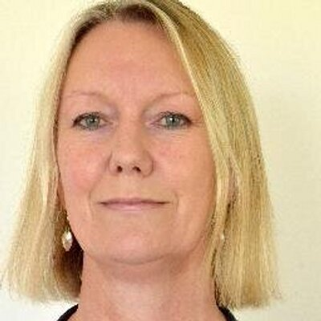
EoE Mentoring scheme
Maria Cooke
Ipswich Hospital
Consultant Obstetrician and Gynaecologist
Short summary of career
Thoughts on mentoring
I graduated from The University of Nottingham in 2004 and nearly all my training has been in the East of England.
I am a Consultant Obstetrician & Gynaecologist at Ipswich Hospital, where I am the Obstetrics Lead and also lead services for Vulnerable Women & Mental Health, Early Pregnancy and Termination of Pregnancy. I am also Programme Director for Coaching and Mentoring for HEE in the region.
As a Trainee in the region I gained a PGCert in Medical Education, took part in the Chief Resident programme and the Quality Improvement Fellows Programme and I also had a year out of programme at HEE East of England office. These have been amazing opportunities for professional development and have enabled me to develop my education, leadership and quality improvement skills.
Mentoring is a valuable tool for personal & professional development and an additional source of support and advice for doctors.
I would like to see it available for all our trainees, and this is what we will be striving to achieve. I hope it will enable trainees to get more value from their training, to see opportunities and reach beyond their aspirations.
Specialist areas
Mentoring
Education
Leadership
Quality Improvement
Personal background
I studied Medicine as a mature student, after completing my family and having taken A levels at evening classes. Unsurprisingly I believe it is possible to achieve whatever you want to achieve – which fits quite well with Mentoring!
I live in Suffolk with my husband and have three grown up daughters who make me proud.
I continually strive for a better work-life balance! In my spare time I like to be in the garden, crafting, reading or walking and I love visiting art galleries – they all allow me to dream….

